Slide 1

High Impact Skills Development Program
in Artificial Intelligence, Data Science, and Blockchain
Module 9: NLP & Sequential Models
Lecture 4: LSTM & GRU
Instructor: Ahsan Jalal

Slide 2
Review of Previous Lecture
RNN
Sequence Model
Recurrence on hidden layer
Limitations –
Vanishing/Exploding Gradient problem
Long Term dependencies
Solutions –
Activation Function – ReLU
Parameter Initialization – Weights to identity matrix, bias to 0
Use more complex recurrent units with gates to control what information is passed through

Slide 3
Long Short-Term Memory
LSTM networks, add additional gating units in each memory cell.
Forget gate
Store gate
Update gate
Output gate
Prevents vanishing/exploding gradient problem and allows network to retain state information over longer periods of time.

Slide 4
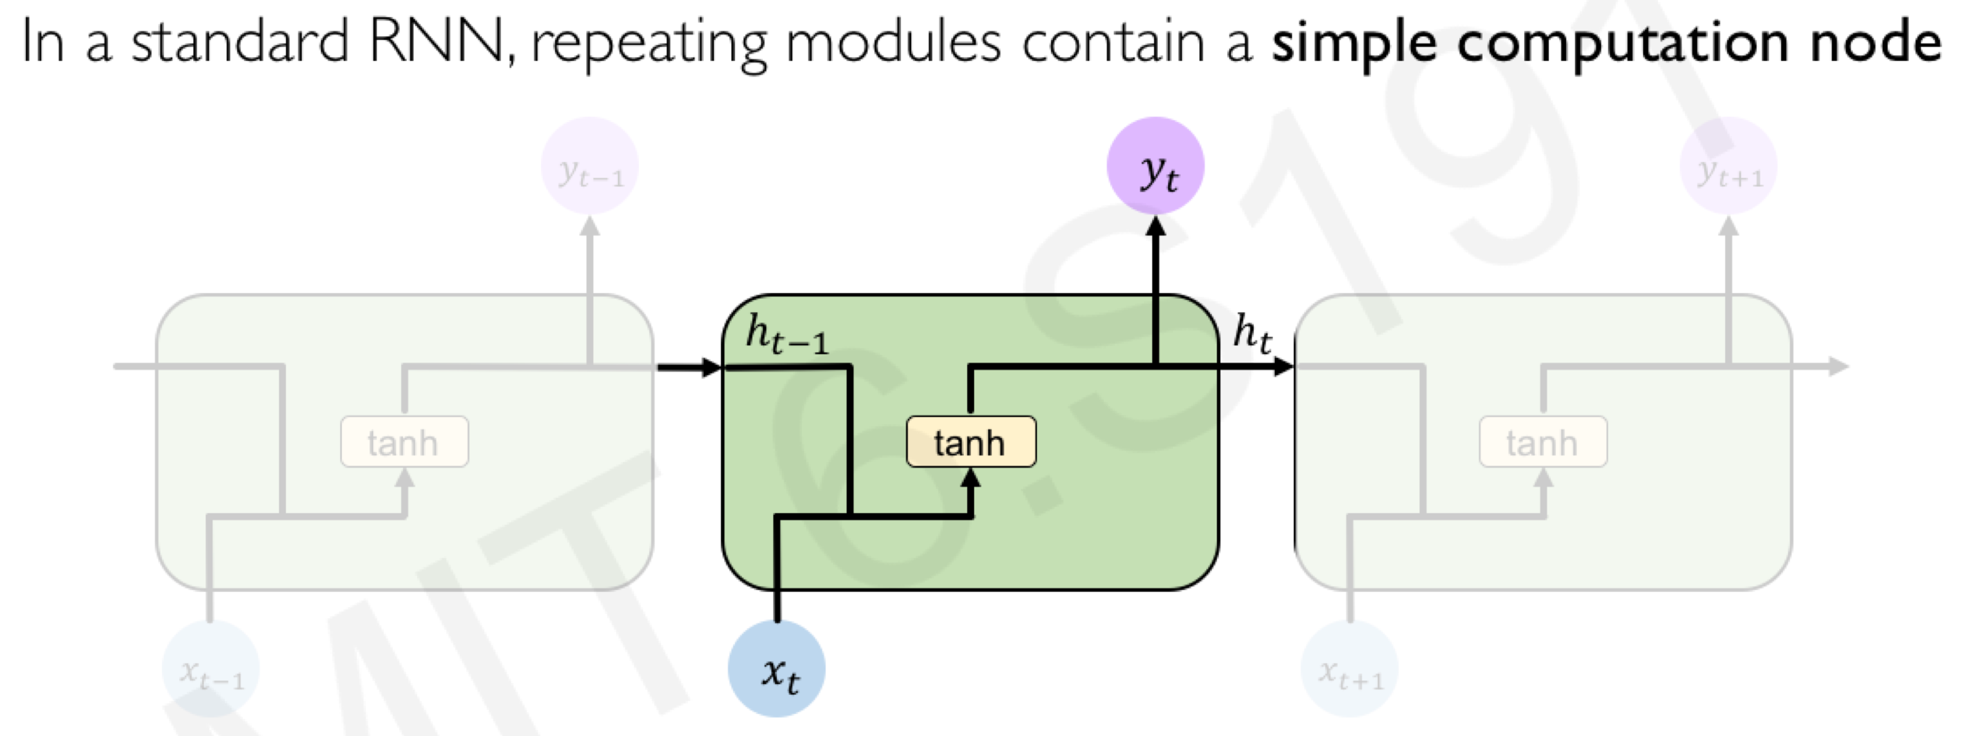
Standard RNN

Slide 5
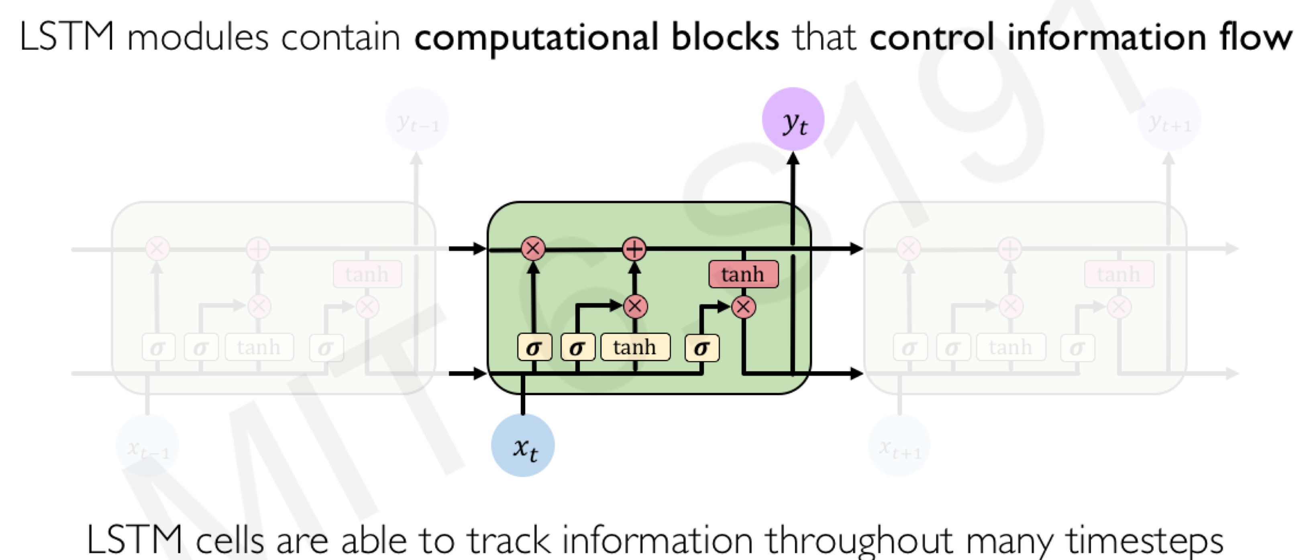
Long Short-Term Memory (LSTM)

Slide 6


LSTM Network Architecture

Slide 7
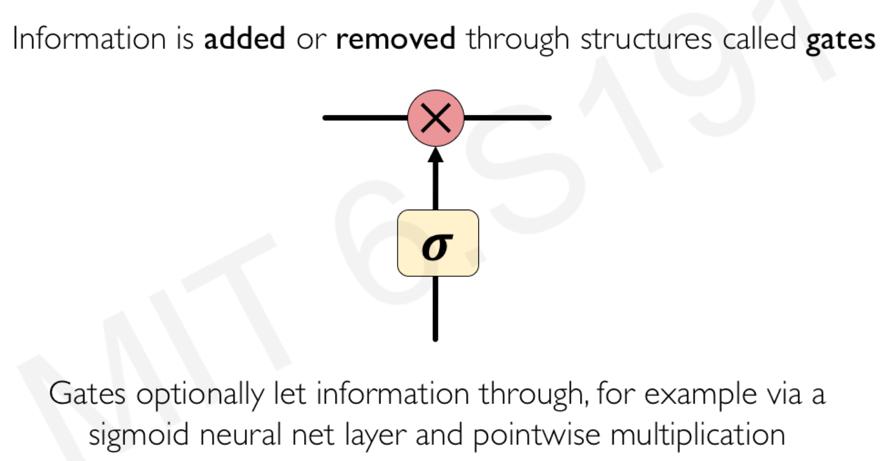
Long Short-Term Memory (LSTM)

Slide 8
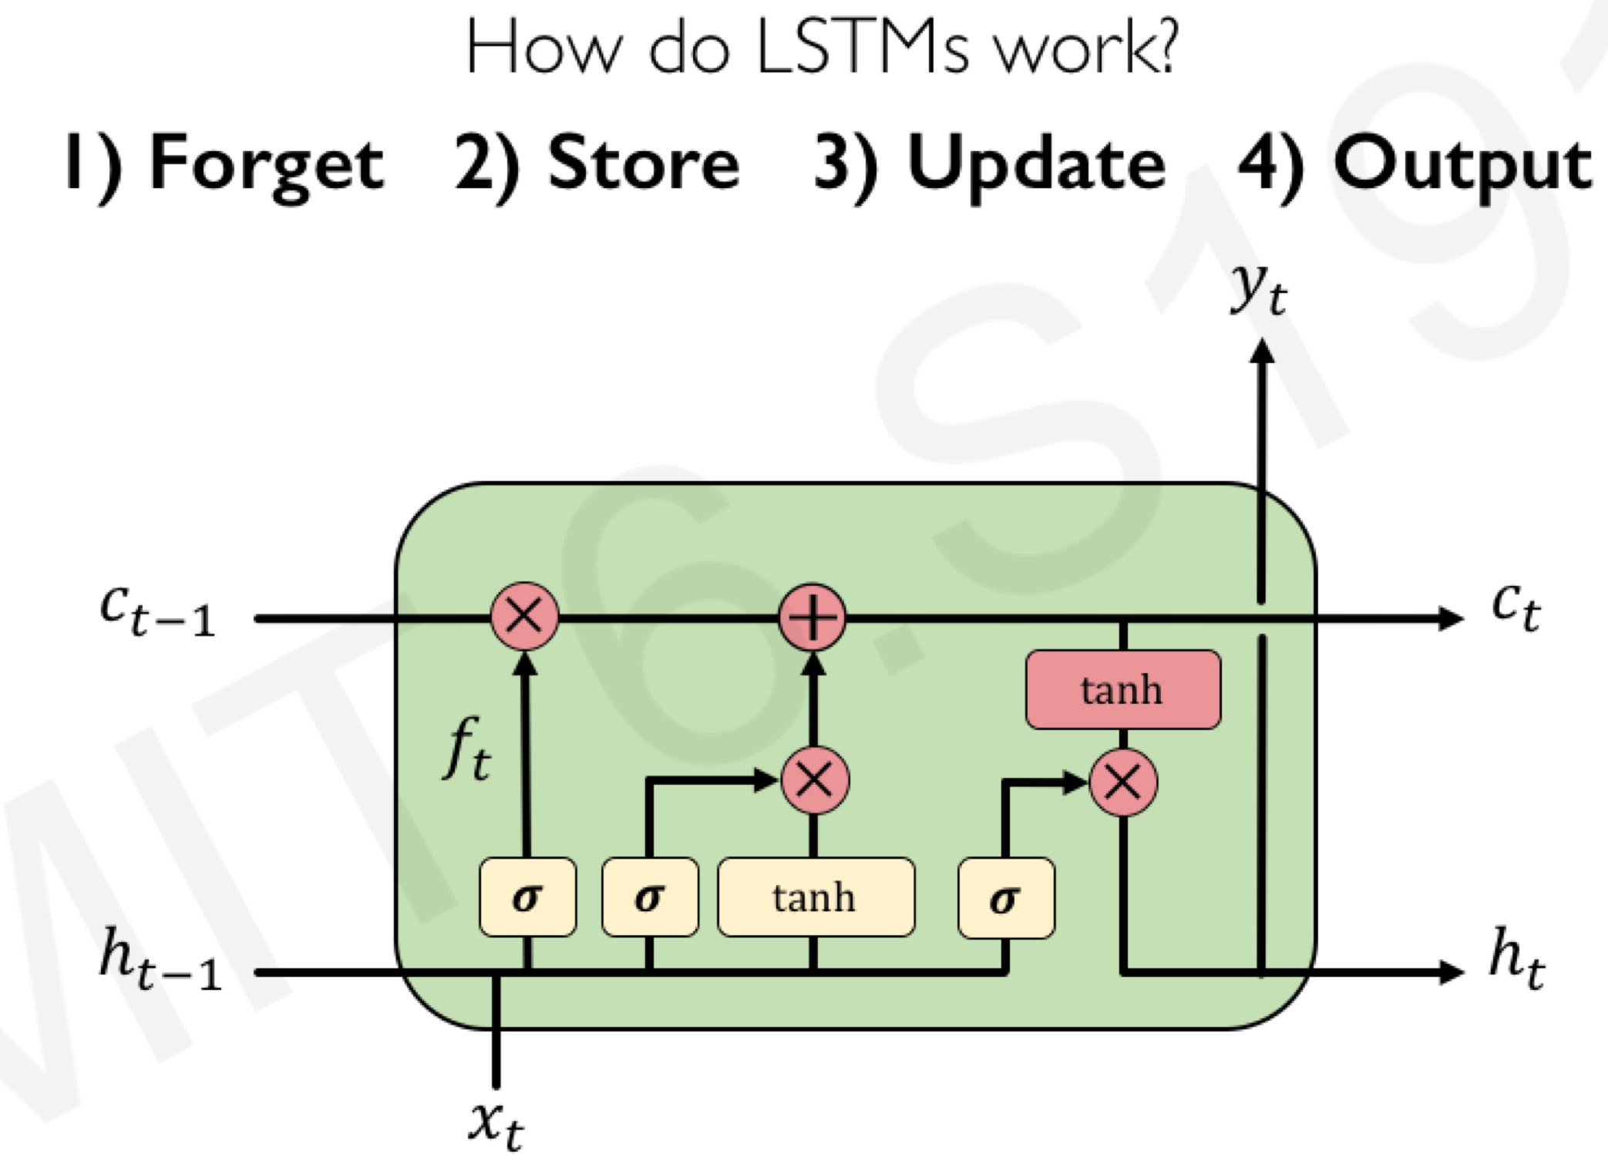
Long Short-Term Memory (LSTM)

Slide 9
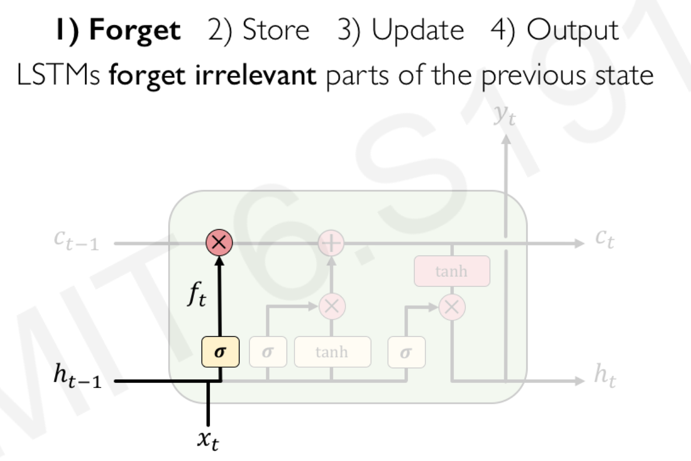

Slide 10

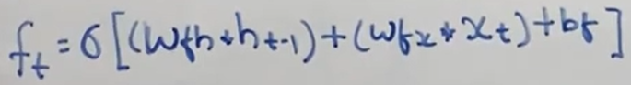
Forget Gate
Forget gate computes a 0-1 value using a logistic sigmoid output function from the input, x_{t}, and the current hidden state, h_{t-1}:
Multiplicatively combined with cell state, "forgetting" information where the gate outputs something close to 0.

Slide 11
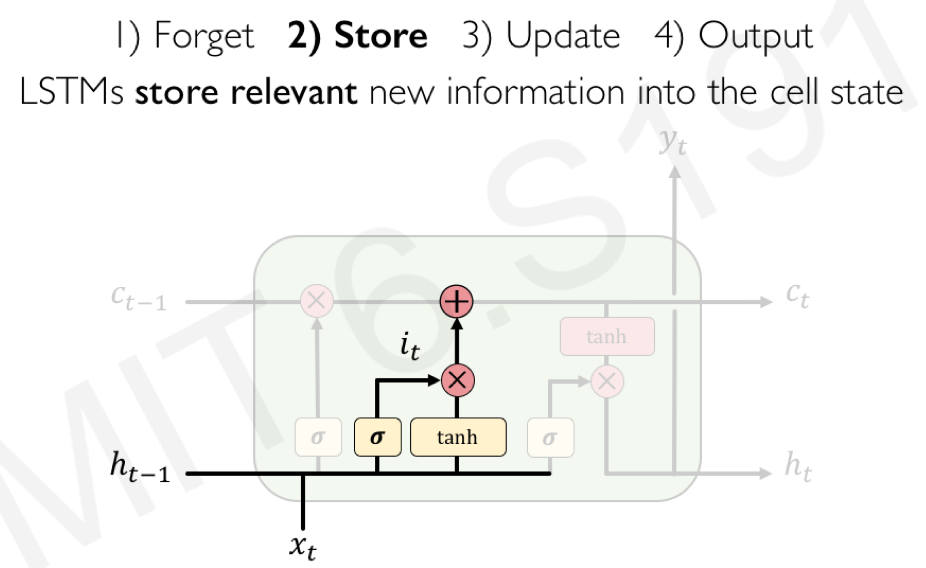

Slide 12

Store/Input Gate
First, determine which entries in the cell state to update by computing 0-1 sigmoid output.
Then determine what amount to add/subtract from these entries by computing a tanh output (valued –1 to 1) function of the input and hidden state.

Slide 13
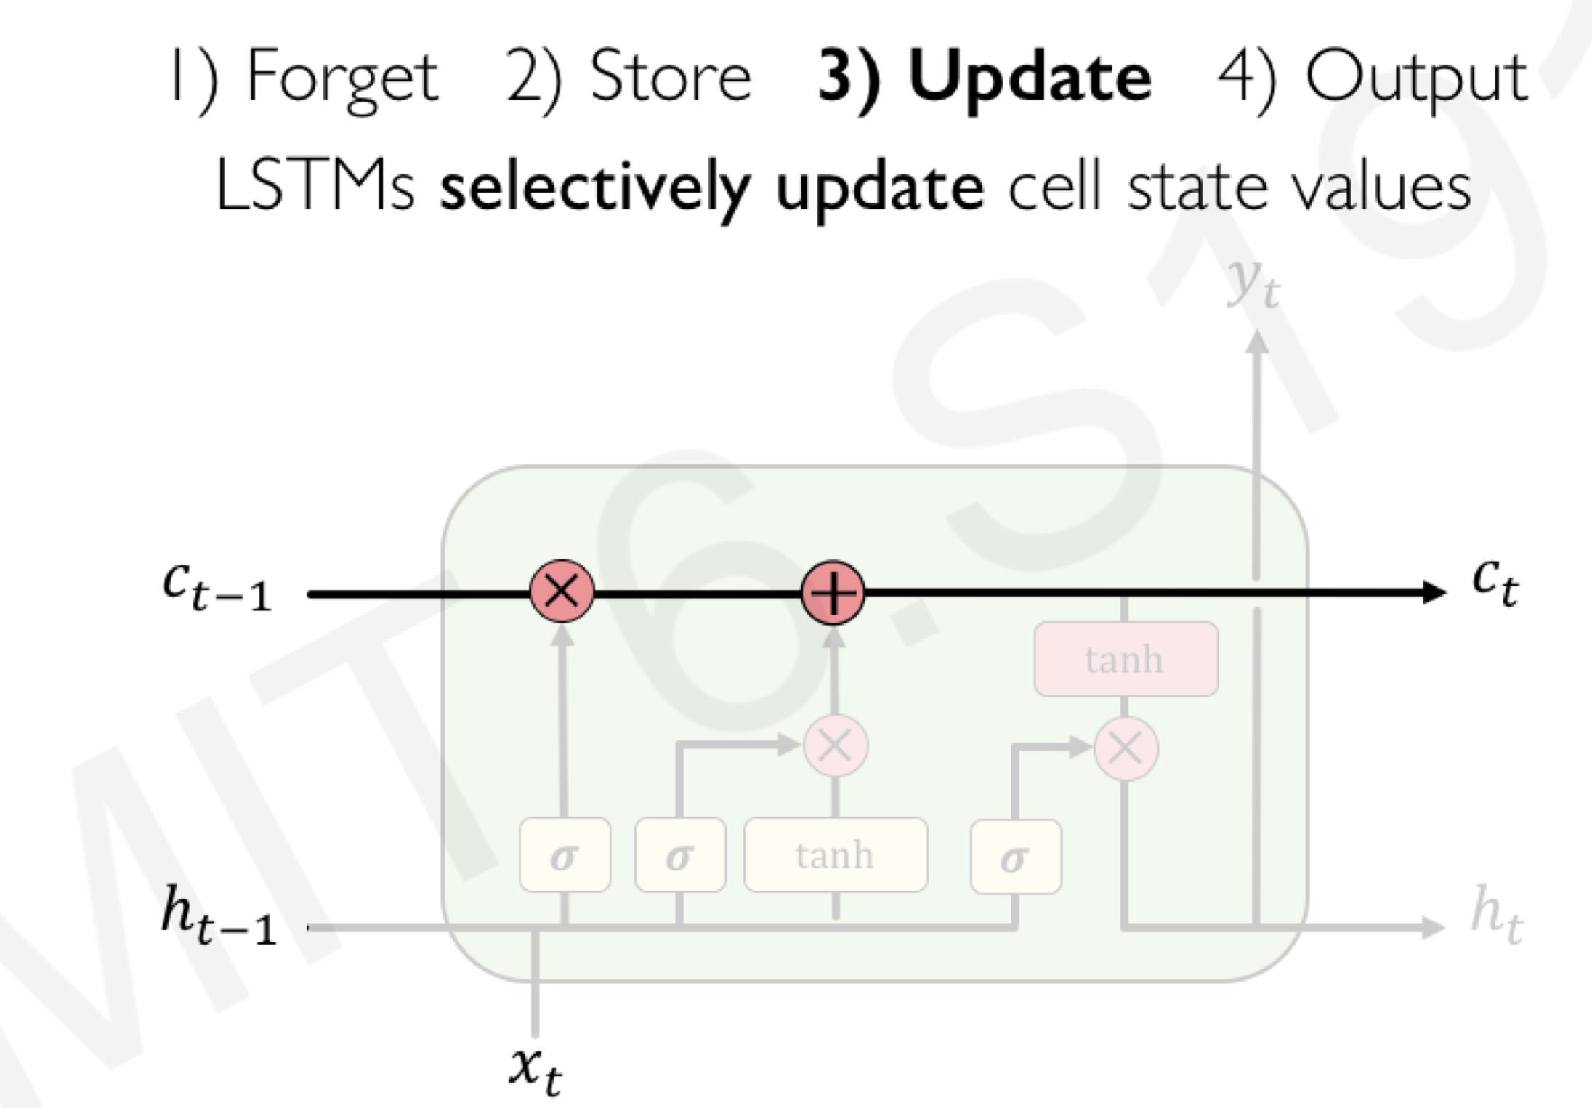

Slide 14

Cell State
Maintains a vector C_{t} that is the same dimensionality as the hidden state, h_{t}
Information can be added or deleted from this state vector via the forget and input gates.

Slide 15

Updating the Cell State
Cell state is updated by using component-wise vector multiply to "forget" and vector addition to "input" new information.

Slide 16
Cell State Example
Want to remember person & number of a subject noun so that it can be checked to agree with the person & number of verb when it is eventually encountered.
Forget gate will remove existing information of a prior subject when a new one is encountered.
Input gate "adds" in the information for the new subject.

Slide 17
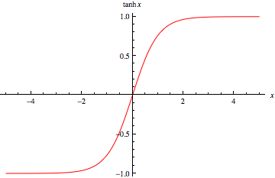
Hyperbolic Tangent Units
Tanh can be used as an alternative nonlinear function to the sigmoid logistic (0-1) output function.
Used to produce thresholded output between –1 and 1.

Slide 18
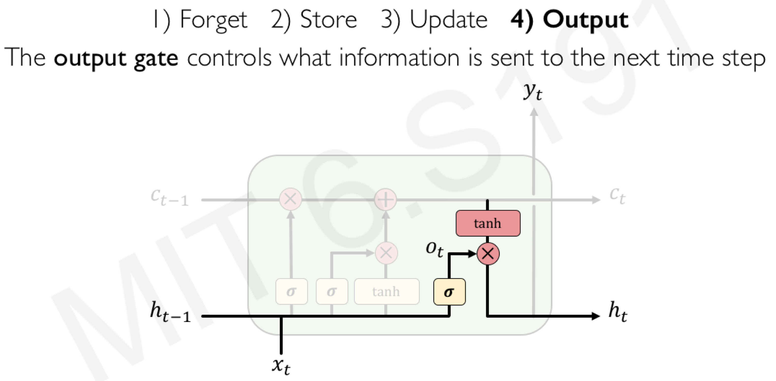

Slide 19

Output Gate
Hidden state is updated based on a "filtered" version of the cell state, scaled to –1 to 1 using tanh.
Output gate computes a sigmoid function of the input and current hidden state to determine which elements of the cell state to "output".

Slide 20
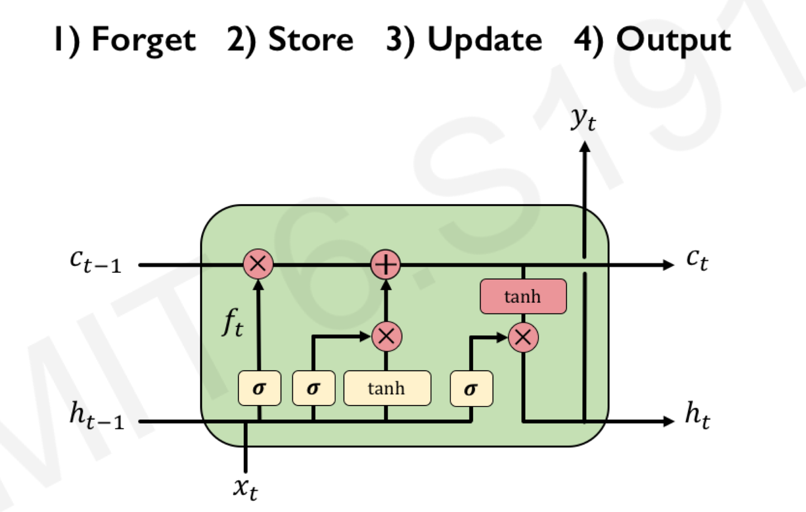
Overall Network Architecture

Slide 21

Overall Network Architecture
Single or multilayer networks can compute LSTM inputs from problem inputs and problem outputs from LSTM outputs.
O_{t}
e.g. a POS tag as a “one hot” vector
e.g. a word “embedding” with
reduced dimensionality
I_{t}
e.g. a word as a “one hot” vector

Slide 22
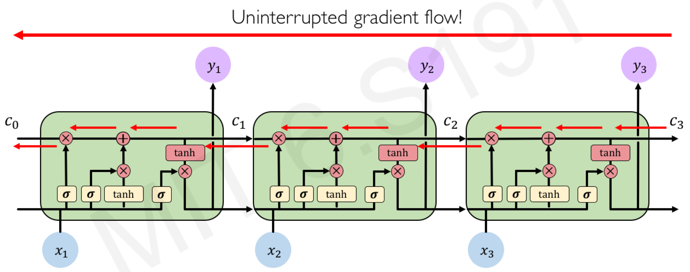
LSTM Gradient Flow

Slide 23
LSTM Training
Trainable with backprop derivatives such as:
Stochastic gradient descent (randomize order of examples in each epoch) with momentum (bias weight changes to continue in same direction as last update).
ADAM optimizer (Kingma & Ma, 2015)
Each cell has many parameters (W_{f}, W_{i}, W_{C}, W_{o})
Generally requires lots of training data.
Requires lots of compute time that exploits GPU clusters.

Slide 24
General Problems Solved with LSTMs
Sequence labeling
Train with supervised output at each time step computed using a single or multilayer network that maps the hidden state (h_{t}) to an output vector (O_{t}).
Language modeling
Train to predict next input (O_{t} =I_{t+1})
Sequence (e.g. text) classification
Train a single or multilayer network that maps the final hidden state (h_{n}) to an output vector (O).

Slide 25
Sequence to Sequence Transduction (Mapping)
Encoder/Decoder framework maps one sequence to a "deep vector" then another LSTM maps this vector to an output sequence.
Encoder
LSTM
Decoder
LSTM
I₁, I₂,…,I_{n}
h_{n}
O₁, O₂,…,O_{m}
Train model "end to end" on I/O pairs of sequences.

Slide 26
Decoder
Output in an other language
Encoder
Input in one language

Slide 27
Successful Applications of LSTMs
Speech recognition: Language and acoustic modeling
Sequence labeling
POS Tagging https://www.aclweb.org/aclwiki/index.php?title=POS_Tagging_(State_of_the_art)
NER
Phrase Chunking
Neural syntactic and semantic parsing
Image captioning: CNN output vector to sequence
Sequence to Sequence
Machine Translation (Sustkever, Vinyals, & Le, 2014)
Video Captioning (input sequence of CNN frame outputs)

Slide 28
Bidirectional LSTM (Bi-LSTM)
Bidirectional LSTMs are an extension of traditional LSTMs that can improve model performance on sequence classification problems.
In problems where all timesteps of the input sequence are available, Bidirectional LSTMs train two instead of one LSTMs on the input sequence. The first on the input sequence as-is and the second on a reversed copy of the input sequence. This can provide additional context to the network and result in faster and even fuller learning on the problem.
To be clear, timesteps in the input sequence are still processed one at a time, it is just the network steps through the input sequence in both directions at the same time.

Slide 29


Bi-directional LSTM (Bi-LSTM)
Separate LSTMs process sequence forward and backward and hidden layers at each time step are concatenated to form the cell output.
x_{t-1}
x_{t}
x_{t+1}
h_{t-1}
h_{t}
h_{t+1}

Slide 30
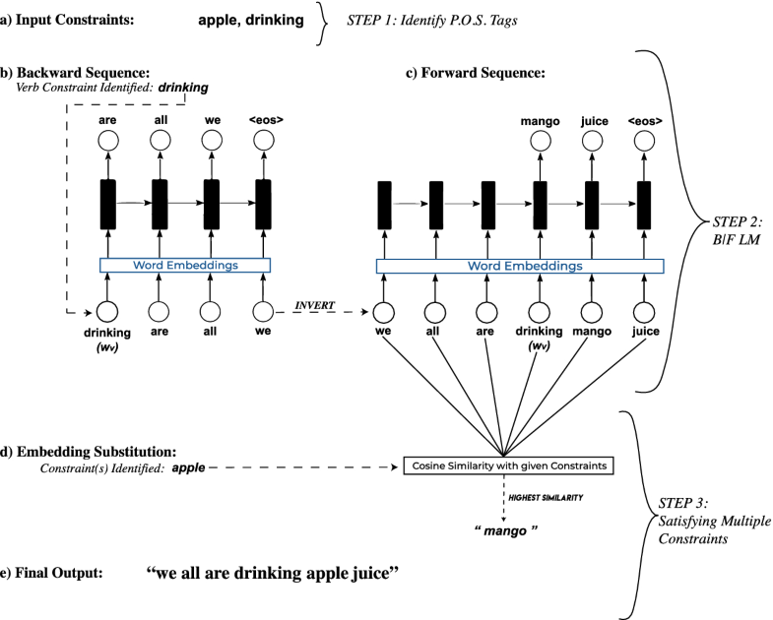
Example - Backward-Forward Sequence Generative Network for Multiple Lexical Constraints
https://link.springer.com/chapter/10.1007/978-3-030-49186-4_4

Slide 31
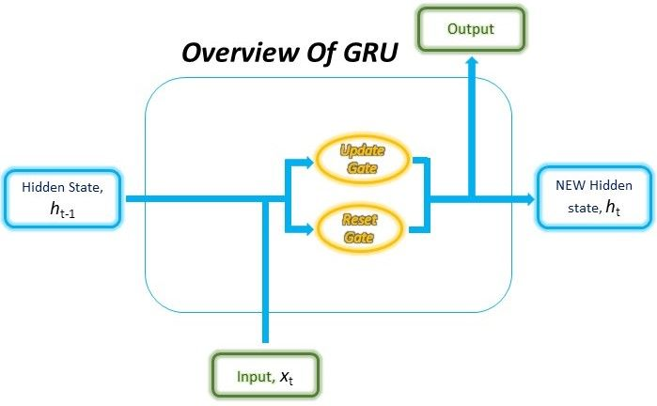
Gated Recurrent Unit (GRU)
Alternative RNN to LSTM that uses fewer gates (Cho, et al., 2014)
Combines forget and input gates into “update” gate.
Eliminates cell state vector
https://arxiv.org/pdf/1406.1078.pdf

Slide 32
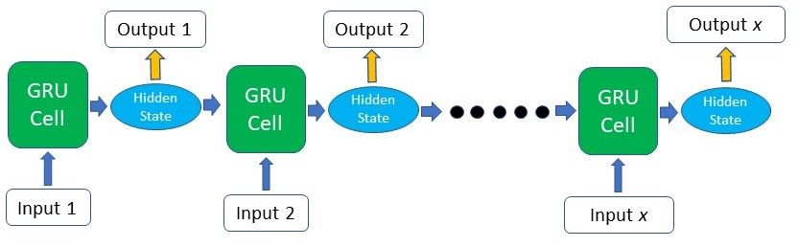
Gated Recurrent Unit (GRU)
The structure of the GRU allows it to adaptively capture dependencies from large sequences of data without discarding information from earlier parts of the sequence.
This is achieved through its gating units and are responsible for regulating the information to be kept or discarded at each time step.

Slide 33

Gated Recurrent Unit (GRU)
The GRU cell contains only two gates: the Update gate and the Reset gate. These gates are trained to selectively filter out any irrelevant information while keeping what’s useful. These gates are vectors containing values between 0 to 1 which will be multiplied with the input data and/or hidden state. A 0 value in the gate vectors indicates that the corresponding data in the input or hidden state is unimportant and will, therefore, return as a zero. On the other hand, a 1 value in the gate vector means that the corresponding data is important and will be used.

Slide 34
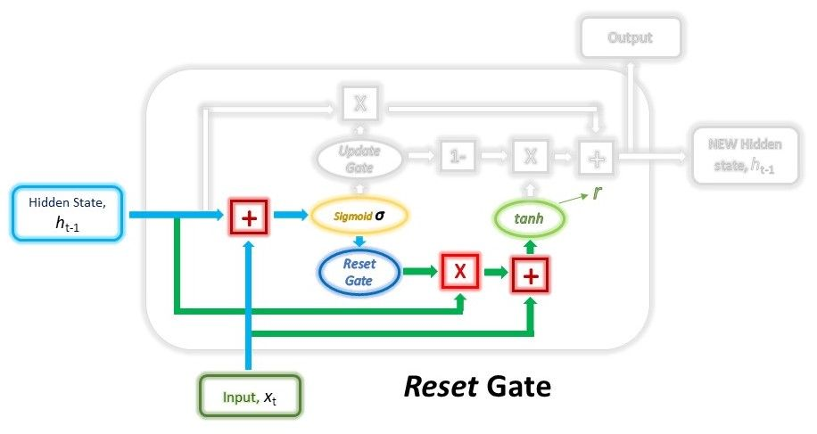
Gated Recurrent Unit (GRU)
Reset Gate
This gate is derived and calculated using both the hidden state from the previous time step and the input data at the current time step.

Slide 35
Gated Recurrent Unit (GRU)
Reset Gate
Mathematically, this is achieved by multiplying the previous hidden state and current input with their respective weights and summing them before passing the sum through a sigmoid function. The sigmoid function will transform the values to fall between 0 and 1, allowing the gate to filter between the less-important and more-important information in the subsequent steps.

Slide 36
Gated Recurrent Unit (GRU)
The previous hidden state will first be multiplied by a trainable weight and will then undergo an element-wise multiplication with the reset vector. This operation will decide which information is to be kept from the previous time steps together with the new inputs. At the same time, the current input will also be multiplied by a trainable weight before being summed with the product of the reset vector and previous hidden state above. Lastly, a non-linear activation tanh function will be applied to the final result to obtain r in the equation below.

Slide 37
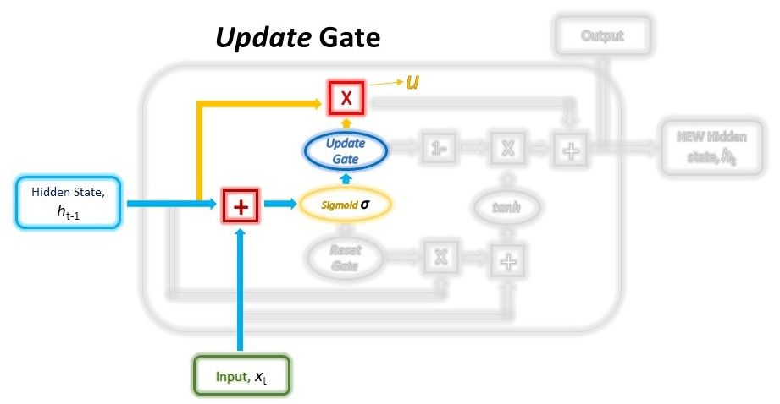
Gated Recurrent Unit (GRU)
Update Gate
Just like the Reset gate, the gate is computed using the previous hidden state and current input data.

Slide 38
Gated Recurrent Unit (GRU)
Update Gate
Both the Update and Reset gate vectors are created using the same formula, but, the weights multiplied with the input and hidden state are unique to each gate, which means that the final vectors for each gate are different. This allows the gates to serve their specific purposes.
The Update vector will then undergo element-wise multiplication with the previous hidden state to obtain u in our equation below, which will be used to compute our final output later.
The purpose of the Update gate here is to help the model determine how much of the past information stored in the previous hidden state needs to be retained for the future.

Slide 39
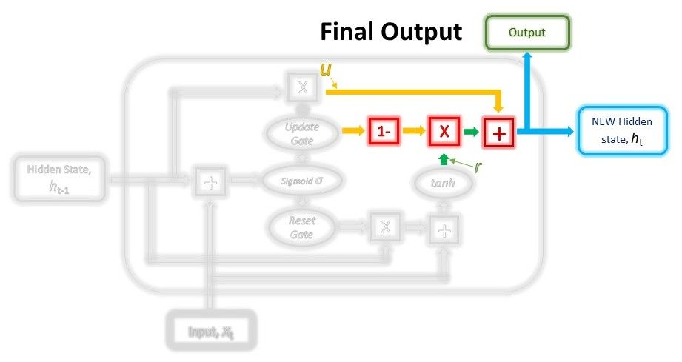
Gated Recurrent Unit (GRU)
Combining the outputs
In the last step, we will be reusing the Update gate and obtaining the updated hidden state

Slide 40
Gated Recurrent Unit (GRU)
Combining the outputs
This time, we will be taking the element-wise inverse version of the same Update vector (1 - Update gate) and doing an element-wise multiplication with our output from the Reset gate, r. The purpose of this operation is for the Update gate to determine what portion of the new information should be stored in the hidden state.
Lastly, the result from the above operations will be summed with our output from the Update gate in the previous step, u. This will give us our new and updated hidden state.
We can use this new hidden state as our output for that time step as well by passing it through a linear activation layer.

Slide 41
GRU vs. LSTM
GRU has significantly fewer parameters and trains faster.
Experimental results comparing the two are still inconclusive, many problems they perform the same, but each has problems on which they work better.

Slide 42
Attention
For many applications, it helps to add “attention” to RNNs.
Allows network to learn to attend to different parts of the input at different time steps, shifting its attention to focus on different aspects during its processing.
Used in image captioning to focus on different parts of an image when generating different parts of the output sentence.
In MT, allows focusing attention on different parts of the source sentence when generating different parts of the translation.

Slide 43
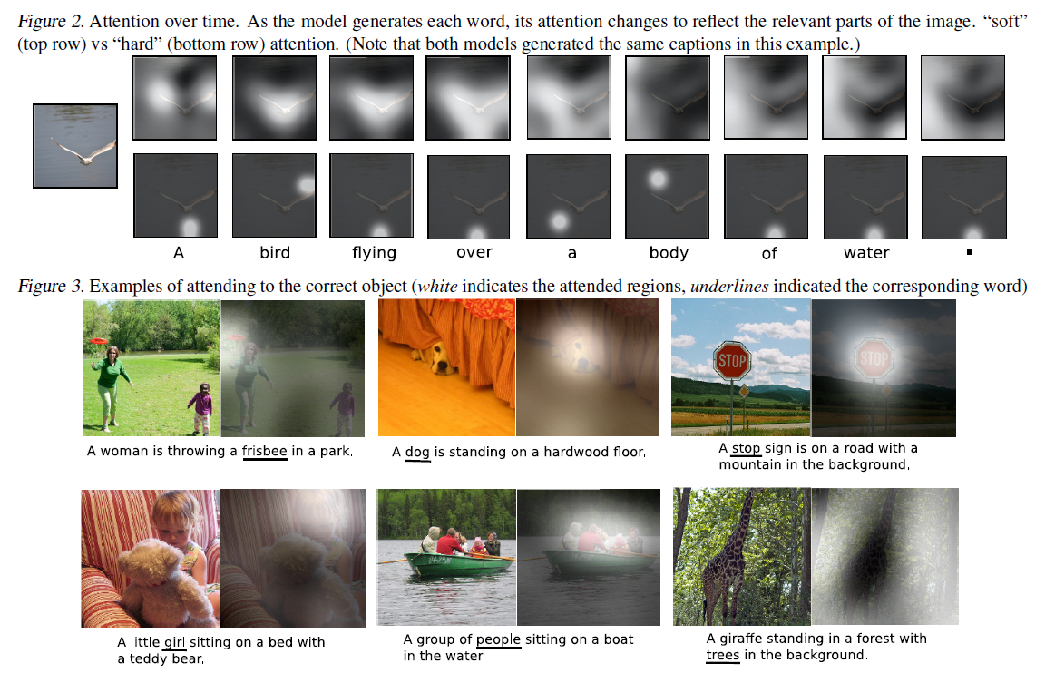
Attention for Image Caption

Slide 44
Conclusions
By adding “gates” to an RNN, we can prevent the vanishing/exploding gradient problem.
Trained LSTMs/GRUs can retain state information longer and handle long-distance dependencies.
Recent impressive results on a range of challenging NLP problems.

Slide 45
Further Learning
https://medium.com/@jianqiangma/all-about-recurrent-neural-networks-9e5ae2936f6e
https://towardsdatascience.com/natural-language-processing-from-basics-to-using-rnn-and-lstm-ef6779e4ae66
http://colah.github.io/posts/2015-08-Understanding-LSTMs/
https://www.youtube.com/watch?v=j_ohosux8bI https://towardsdatascience.com/recurrent-neural-network-head-to-toe-d58ff2f2dab3
https://medium.com/datadriveninvestor/how-do-lstm-networks-solve-the-problem-of-vanishing-gradients-a6784971a577

Slide 46
GRU vs. LSTM
GRU has significantly fewer parameters and trains faster.
Experimental results comparing the two are still inconclusive, many problems they perform the same, but each has problems on which they work better.

